Slide 1
Statistical Product Acceptance in Component Standards using IAQG 9138: The Brief Explanation
Rev. New
19 September 2018
www.iaqg.org/scmh Section 3.7.8 & Appendix 8
Notes:
IAQG 9138 “Statistical Product Acceptance Requirements” is published in Europe by ASD-STAN as “prEN 9138”, in the Americas by SAE International as “AS9138”, and in Asia as “SJAC 9138.”

Slide 2
Overview
Many legacy standards (such as for fasteners or electronic / hydraulic components) have required the use of specified AQL sampling levels for quality, with implicit or explicit reference to MIL-STD-105, ANSI/ASQ Z1.4, or ISO2859-1, or equivalent.
The original mathematical definition of the AQL measured producer protection rather than consumer protection.
The US military had invented the AQL concept in the 1940’s, but in the 1990’s they removed that requirement from all their standards and recommended against its further usage.
The ANSI and ISO organizations subsequently redefined the acronym in an attempt to change the interpretation of the metric, but the tables and mathematics remained unchanged.
Notes:
The acronym “AQL” is currently defined in these standards as the “Acceptance Quality Limit”. When the concept was originally invented it was called “Acceptable Quality Level”, and that definition held from 1942 until about 2003.
The current revisions of those standards define the “AQL” in words that do not allow one to calculate a sample size from the AQL. Today’s nonmathematical definitions began with a revision to MIL-STD-105 in 1963. The words and format were changed in 1963, but the values were kept “close” to the values from the previous mathematical definition. That previous mathematical definition was “the nonconformance rate which produces 95% probability of the lot being accepted under this sampling plan”. This mathematical definition guaranteed to the producer, with 95% confidence, that if they had a nonconformance rate equal to the AQL, then the sample sizes would be too small to find all the nonconformances. Today we are recommending a new focus on consumer protection.

Slide 3
A step forward from the IAQG
The International Aerospace Quality Group (IAQG) was formed in the late 1990’s to create a common quality management system for the global aerospace community.
In 2001 the IAQG started the project to develop a new statistical product acceptance standard.
The IAQG sector for North and South America was assigned to develop the new standard, use it for several years to make sure it worked, then bring it back to the rest of the IAQG for global implementation.
The release of IAQG 9138 this year (2018) completes that project.
There is now a consumer protection - based alternative to the AQL-based legacy systems…

Slide 4
US FAA support
“We found the Initial Reliability requirement (IRR) to be a significant upgrade and replacement for the long-standing Acceptable Quality Level (AQL) values which we have been using since the 1940s.….hence we heartily support the switch to IRR.”
“Finally we found full implementation of the safeguards designed for use of Statistical Process Control (SPC) adequate to allow its use for product acceptance purposes. This represents a departure from our previous stance on SPC for product acceptance, ……..”
Notes:
This US FAA “Best Practice” document was published in 2006, and led the way for the transition to the current AC21-43A.

Slide 5
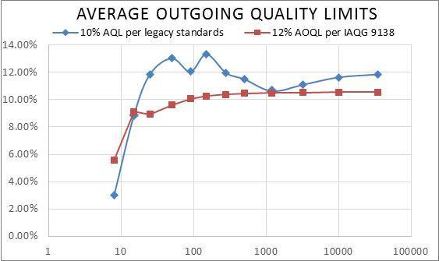
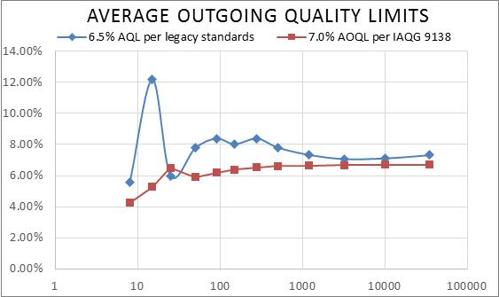
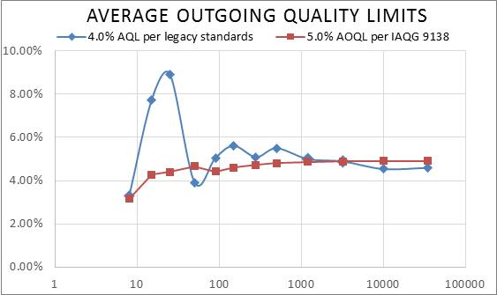
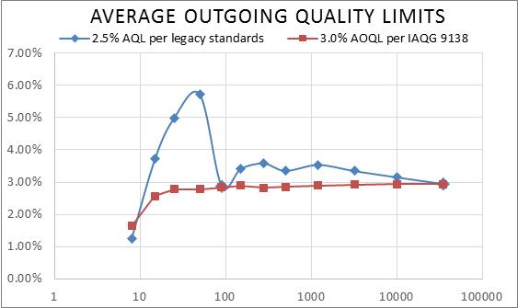
Consumer Protection under AQLs
Notes:
These charts show in blue the maximum escape rates allowed by legacy sampling tables such as ISO2859-1, ANSI/ASQ Z1.4, MIL-STD-105, etc. The red curves show corresponding protection provided by the new IAQG 9138.
Notice how the risk to the consumer in legacy sampling tables is varying across the next several slides, generally higher for small lots than for larger lots. This inconsistency is a concern. The engineers calling out for a standard component may reasonably be planning on the same level of quality regardless of the lot sizes being produced or procured. Therefore, the new IAQG 9138 standard provides as close as possible to a constant level of quality protection for all lot sizes.

Slide 6
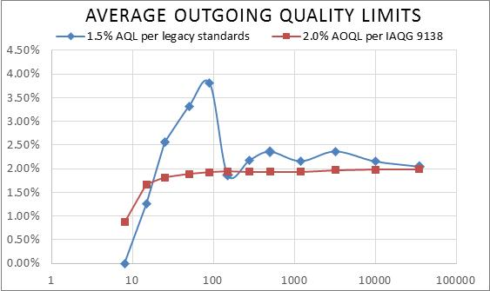
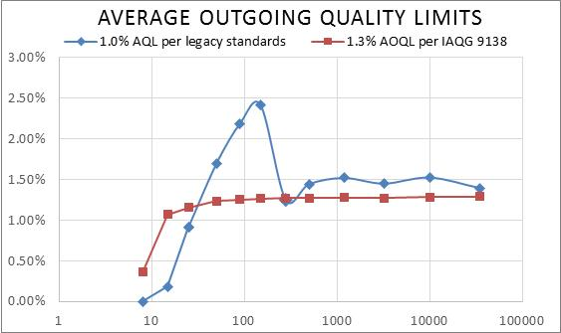
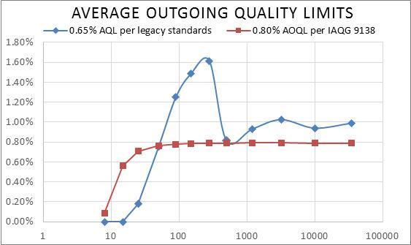
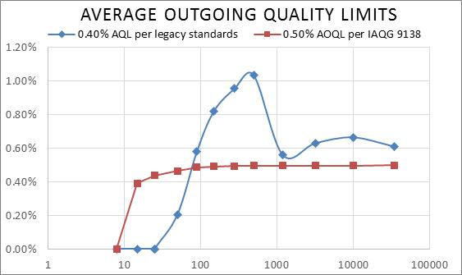
Consumer Protection under AQLs
Notes:
On these graphs, there is a portion of the blue curve that goes below the red curve. In those lot size ranges, the legacy sampling tables require sample sizes that are over half the size of the whole lot, and practically speaking, inspectors will not do that. The process of selecting a representative sample is generally hard enough that the inspectors would prefer to just inspect all the units, rather than to individually select units to inspect and to end up inspecting over half of them anyway. So, the 9138 team recommends that the comparison focus on the lot sizes that are at least 3 times the size of the minimum sample.
The 9138 team also notes that the far right of these graphs shows very large lot sizes that are rare in the aviation, space and defense industries. We benchmark equivalence with a focus on the lot sizes that most often will actually be used.

Slide 7
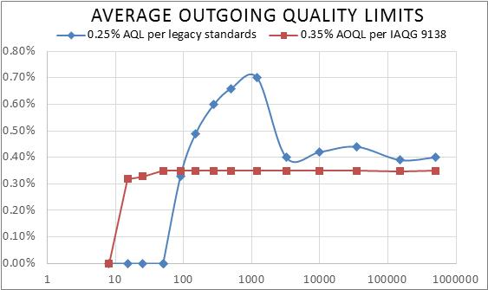
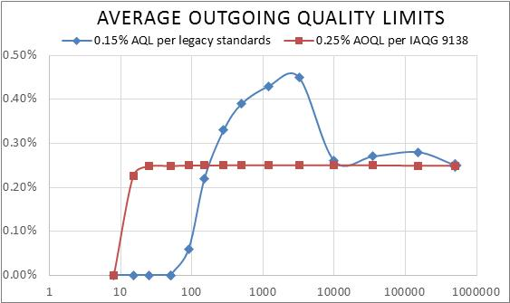
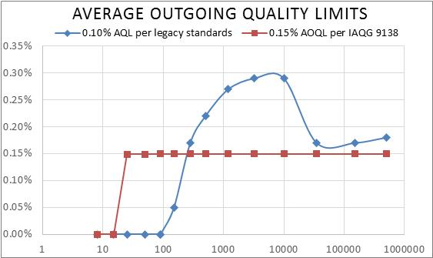
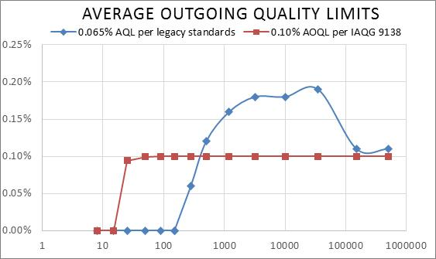
Consumer Protection under AQLs
Notes:
The 9138 team recommends these AQL-IRR equivalences in a pattern that preserves the relative protection relationships between the original AQLs, only applied to consumer protection. Each of the original AQL values was about 60% larger than the next smaller AQL value, so here the maximum nonconformance rates to the consumer are also in these roughly 60%-spaced increments. (The original table was designed to have each column AQL be ~10^{(1/5th)} times the next smaller AQL.)

Slide 8
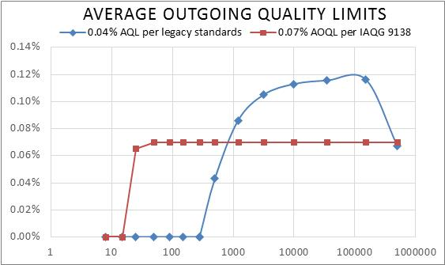
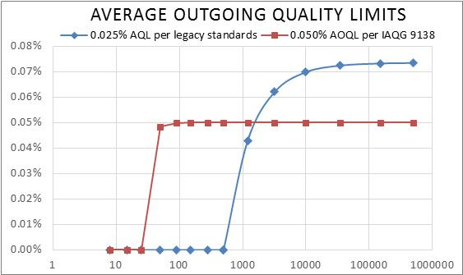
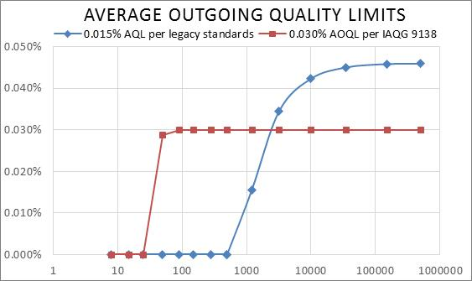
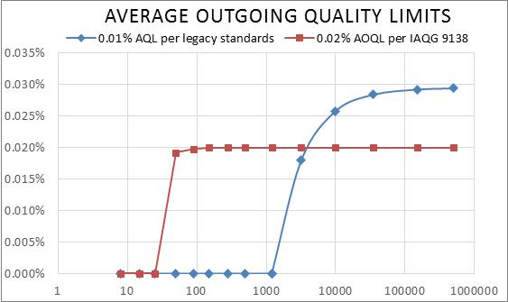
Consumer Protection under AQLs
Notes:
The values of the AQL on this slide were very rarely used, because the sample sizes required are so very large (the smallest sample size on this slide is over 300). However, we have included all the AQL values known to have been used in the legacy standards for aviation, space and defense industries. If there is another AQL in use, and you would like to know what a consumer protection alternative might be, feel free to contact the 9138 team through the SCMH “Contact Us” tool.

Slide 9
Recommended Replacements
To obtain the more consistent protection of IAQG 9138, replace any references to AQL-based sampling standards with a reference to the appropriate IRR and to 9138.
The 9138 team recommends not using attribute (pass/fail) sampling for any IRR value tighter than 99%. For greater protection, consider requiring the use of actual measurements in a variables sampling plan, and the ongoing Engineering analysis of the process with SPC.
AQL | 0.01% | 0.015% | 0.025% | 0.04% | 0.065% | 0.10% | 0.15% | 0.25%
IRR | 99.98% | 99.97% | 99.95% | 99.93% | 99.90% | 99.85% | 99.75% | 99.65%
AQL | 0.40% | 0.65% | 1.00% | 1.50% | 2.50% | 4.00% | 6.50% | 10.00%
IRR | 99.5% | 99.2% | 98.7% | 98% | 97% | 95% | 93% | 88%
Notes:
The original AQL-AOQL transition table given in MIL-STD-1235 was based on MIL-STD-105A and lot sizes of 3000 according to the QSTAG report referenced in 9138 Section 2. If you are instead transitioning from the current revisions of ISO2859-1 or ANSI/ASQ Z1.4, those are based on MIL-STD-105 revision D, and today’s usage is likely not a steady use of lot sizes of 3000. For the current and future Engineering revisions, the table on this slide is the 9138 team’s recommended conversion.

Slide 10
Other Reasons to Refer to 9138
Measurement Risk controls
Randomization support (representative samples)
Retrievability requirements
“c=0” for certain regulatory or contractual authorities
Traceable method to “ensure conformance”
Flexibility of handling diverse manufacturing processes
Individual lot
Five different rectification policies, see SCMH 3.7.4 for sample sizes
Series of smaller lots
With and without switching rules
One unit at a time
Five strategies for qualifying for fractional inspection, see SCMH 3.7.6
SPC and more advanced methods for product acceptance
Notes:
These are other sampling issues that affect the delivered conformance rates of your products and which are handled by IAQG 9138.
One issue in particular is that the math underlying older standards always expected that rejected lots would be screened and all nonconformances would either be corrected or the whole unit replaced with a conforming unit. However, in many applications (such as receiving inspection) the actual practice that developed was to send a rejected lot back to its source without screening. The mathematics required to protect the consumer changes radically for different strategies of dealing with rejected lots, and 9138 provides solutions for several different widely used disposition strategies.
Sampling tables for all five lot rectification policies (SCMH 3.7.4) and for five different one-at-a-time sampling plans (SCMH 3.7.6) are included in the Supply Chain Management Handbook (www.iaqg.org/scmh).
Statistical Process Control, or SPC, is a popular process improvement tool that can also be used for product acceptance under certain conditions.

Slide 11
To transition a standard to using 9138
The subject Technical Specification needs to be modified, changing the AQL based sampling to IRR based sampling and referencing 9138.
Use the preceding pages to find the IRR number that relates to the AQL number currently specified. Verify that this level of protection meets the intent of the standard committee.
If desired, the spec can put in a table of sample sizes for the appropriate IRR number. Choose an appropriate rectification policy or sampling method and go to the matching SCMH table.
Consider the wording above any such table so that process controls and other methods may be used in place of lot sampling when appropriate to provide the same level of protection.
Accompany this with a statement that no known non-conformances will be accepted and that the statistical product acceptance shall be in accordance with 9138.
It is suggested that these changes are made at the next planned revision of the technical specification. Implementation should be due one calendar year after the standard revision.
Further help is available from the 9138 team through the SCMH.
Notes:
“It is important for user flexibility that the standard precede any sampling table with wording like the following: “The required IRR may be satisfied using the following table and the associated policies (rectification, etc.).”

Slide 12
Conclusion
IAQG 9138 provides an industry standard way to demonstrate compliance with requirements “to ensure that each [unit] conforms”
Many new tools and training resources on the IAQG website ( www.iaqg.org/scmh ) will help OEM factories, and suppliers without OEM statistical resources
Internal OEM factories and selected suppliers can also use OEM-developed tools to satisfy 9138 requirements even more efficiently
Notes:
This slide uses the acronym “OEM” for “Original Equipment Manufacturer” to designate large companies in the aviation, space and defense industries that have adequate resources to develop new statistical tools and to verify their accuracy.
The portion of IAQG website (http://www.iaqg.org) called the “Supply Chain Management Handbook” (selection on the left side of the screen in the middle or http://www.iaqg.org/scmh) contains many tables and other resources. See SCMH 3.7 and the training modules in SCMH Appendix 8. The SCMH does require a user to sign up, however, there is no cost or approval required, the sign-up is solely to report to the companies funding the website about how much it gets used.

Slide 13
Contact: scmh Support Manager or iaqg 9138 team (www.iaqg.org/scmh)
Statistical Product Acceptance in Component Standards using IAQG 9138: The Brief Explanation
Notes:
Note: Password to edit this presentation is "IAQG9138SPA".

